Slide 1

Analysis of heat conduction of UO₂ fuel pellet under steady state and transient condition in MOOSE
NE 591 Class Presentation 3
Khadija Mahbuba
Graduate Student
Department of Nuclear Engineering
North Carolina State University

Slide 2
Outline
Problem statement
Solution approach
Results
Conclusion

Slide 3
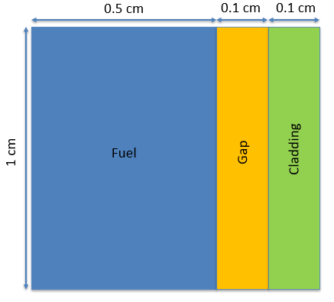
Problem statement
Fuel pin dimensions listed
Fuel thermal conductivity: 0.3 W/cm-K
Cladding thermal conductivity: 0.17 W/cm-K
Gap thermal conductivity: 0.1 W/cm-K
Outer cladding: 500 K
Mesh: 100x100
Solve temperature profile for:
Steady-state: Volumetric heating rate: Q = 250 W/cm³
Solve for centerline temperature vs time
Transient: Volumetric heating rate: Q = 150*EXP(-0.03*time)+250, for up to t=200

Slide 4

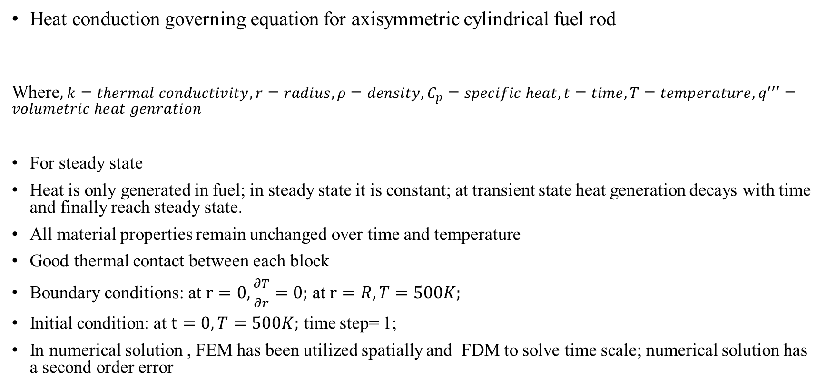

Solution approach
Heat conduction governing equation for axisymmetric cylindrical fuel rod
Where, $k=thermal conductivity, r=radius, ρ=density,C_{p}=specific heat,t=time, T=temperature,q^{′′′}=volumetric heat genration$
For steady state
Heat is only generated in fuel; in steady state it is constant; at transient state heat generation decays with time and finally reach steady state.
All material properties remain unchanged over time and temperature
Good thermal contact between each block
Boundary conditions: at $r=0,\frac{∂T}{∂r}=0;$ at $r=R,T=500K;$
Initial condition: at $t=0,T=500K;$ time step= 1;
In numerical solution , FEM has been utilized spatially and FDM to solve time scale; numerical solution has a second order error
$\frac{1}{r}.\frac{∂}{∂r}\left(rk\frac{∂T}{∂r}\right)−q^{′′′}=ρC_{p}$ $\frac{∂T}{∂t}$
$$\frac{1}{r}.\frac{∂}{∂r}\left(rk\frac{∂T}{∂r}\right)−q^{′′′}=0$$

Slide 5
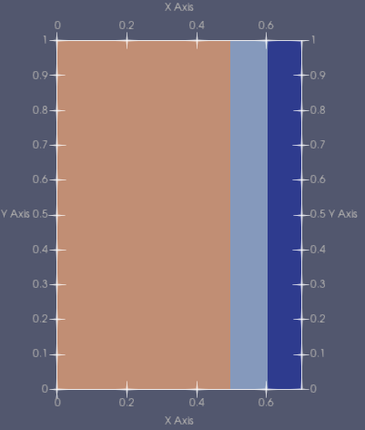
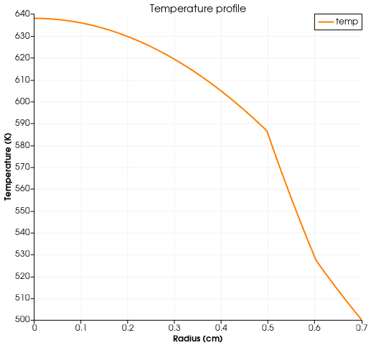
Results (steady state)
Fuel centerline
ClAD
GAP
FUEL
From analytical solution
T(0)=632. 5031 K (centerline temperature)
T(0.5)=580.4198 K (fuel surface temperature)
T(0.6)=528.3365 K (clad inner surface temperature)
MAX error in numerical solution is 1.1%!!

Slide 6
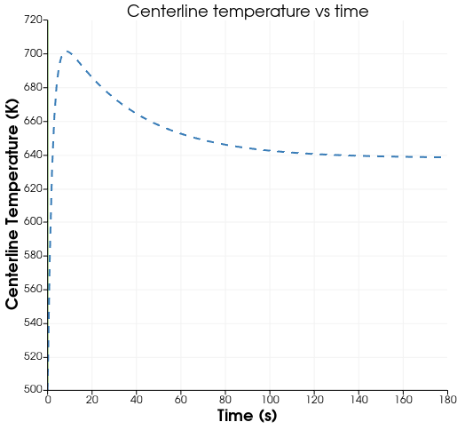
Results (transient)
Fuel centerline
ClAD
GAP
FUEL
Steady state
Initially there is a sudden increase in centerline temperature because of the initial temp (500K)<< steady temp (638K)
Maximum centerline temp. is approx. 700K which is far below than UO₂ melting point.3138 K
After 170sec time centerline temp reaches steady state, which numeric value is same as the steady state condition

Slide 7
Conclusion
From numerical method we have found reliable result
As gap has the least thermal conductivity, maximum temperature drop is found in that region (52K)
Linear temperature profile at clad and gap region, whereas parabolic profile in fuel region.
After about 2.8 min transient system becomes steady state, this time is strongly dependent on thermal diffusivity .
Centerline temperature profile with respect to time is governed by the volumetric heat generation profile.
After 178 sec, system did not converge, this happens as after long time exponential term in the heat generation function, becomes very unstable. This convergence does not depend on time step value.
By modifying geometry, this method can be implemented for 2D case also.

Slide 8
Thank you!

